Slide 1
Nool OCR Framework for printed text
Fizer Khan

Slide 2
ABSTRACT
Optical Character Recognition (OCR) is a process of converting printed materials into text or word processing files that can be easily edited and stored.
The technology has enabled such materials to be stored using much less storage space than the hard materials.

Slide 3
Now a day there are lot of OCR available in the market for different languages but there is no centralized framework for all languages.
The intension of the project is to create a framework capable to handle all available languages.
This can be achieved through Eclipse plug-in architecture.

Slide 4
DEVELOPMENT ENVIRONMENT
ECLIPSE 3.6
Eclipse is a multi-language software development environment comprising an integrated development environment (IDE) and an extensible plug-in system.
It is written primarily in Java and can be used to develop applications in Java and, by means of various plug-ins.

Slide 5
JAVA 1.6
Java is a general-purpose, concurrent, class-based, object-oriented language that is specifically designed to have as few implementation dependencies as possible.
Java is currently one of the most popular programming languages in use, and is widely used from application software to web applications.

Slide 6
WINDOWS OS
Windows 7, the latest in the series of Windows-based operating systems, is developed to make your tasks simpler and easier.
It’s faster and more reliable in performance than its predecessors.

Slide 7
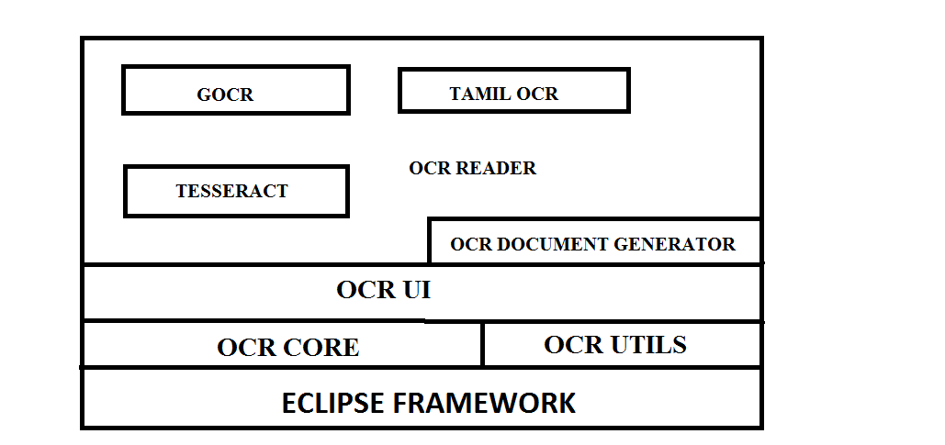
OCR ARCHITECTURE

Slide 8
MODULES
OCR Architecture involves the following modules
        OCR Core
        OCR Utils
        OCR User interface
        OCR Document generator
        OCR Readers

Slide 9
OCR Core
OCR Core provides core functionalities to the OCR framework.
The module OCR Builder has extension points in order to support for different OCR and different languages.
The module document generator provides way to generate different type of document such as PDF, DOC, EPUB and etc.

Slide 10
OCR Utils
OCR Utils exposes the API for general functionalities.
The file package helps to do file operation.
The resource package helps to do eclipse resource operation such as nature settings, preference settings and etc.

Slide 11
OCR User interface
OCR UI is a plug-in which has implementation of all GUI.
This implements OCR perspective, OCR Views, OCR Menus, toolbars, Console and etc.
The read image, import image and generate document.

Slide 12
OCR Document generator
OCR Document Generator is a PDF Generator to generate PDF document from generated text files.

Slide 13
OCR Readers
OCR Readers are the real implementation of reading images and generating text file.
This is just an extension of OCR builder extension point.
Theoretically, We can have infinite number of OCR Reader in the OCR framework for different languages.

Slide 14
SCREEN SHOT

Slide 15
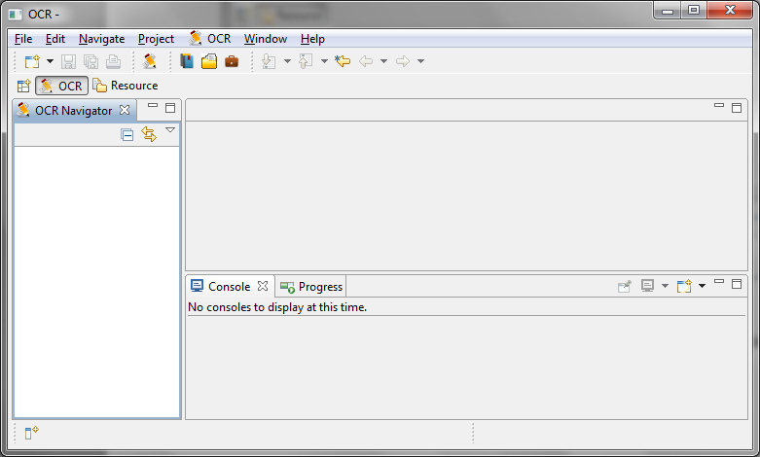
OCR Perspective

Slide 16
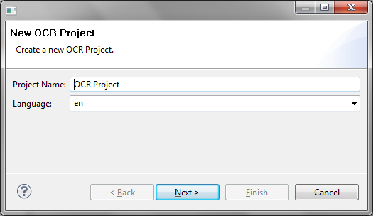
New OCR Project Wizard

Slide 17
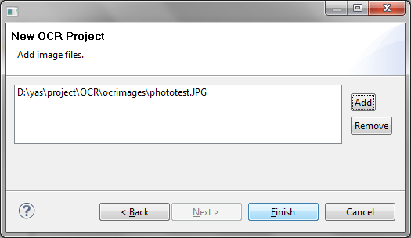
New Project Wizard - Add Images Page

Slide 18
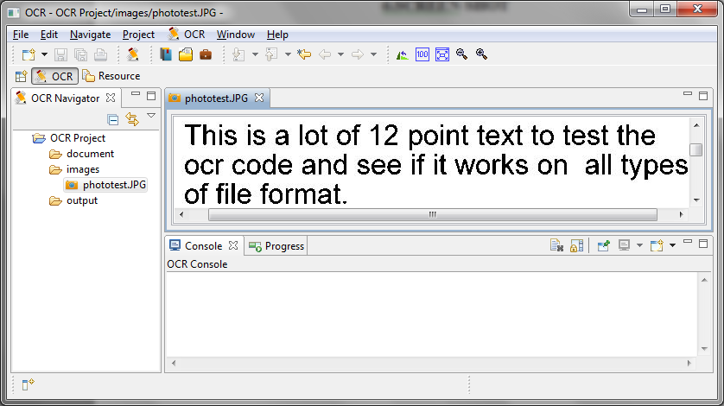
Image Viewer

Slide 19
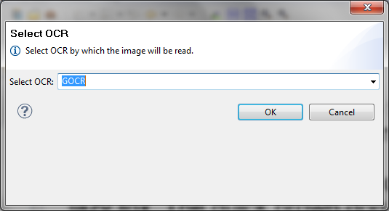
Read Images – Select OCR Type

Slide 20
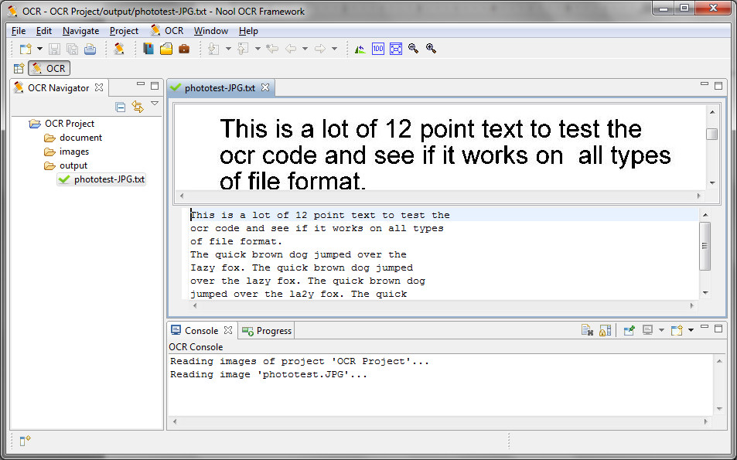
OCR Proof Reader

Slide 21
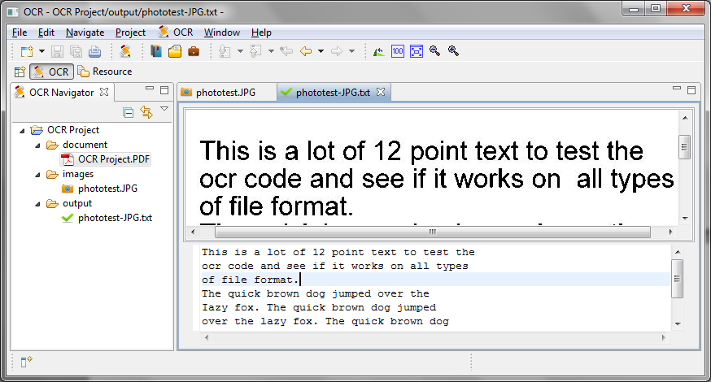
Error Correction

Slide 22
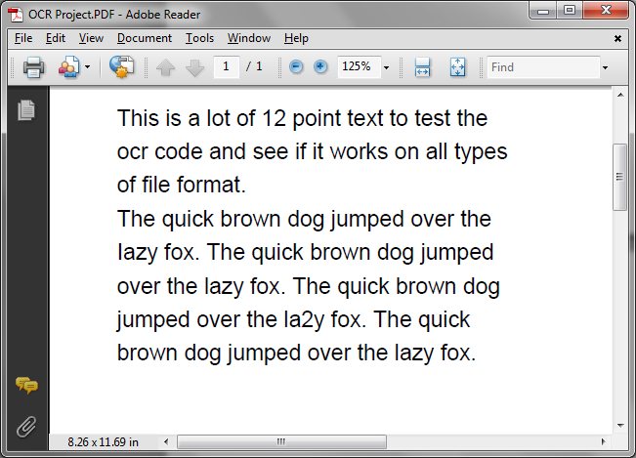
PDF Viewer

Slide 23
CONCLUSION
Nool OCR will enable us to convert more old books into digitalized format which helps our next generation to understand the things in short period of time.
Moreover E-Publishing and mobile devices become flourishing market in the world. We hope, this tool help them to create e books.

Slide 24
REFERENCES
http://en.wikipedia.org/wiki/Optical_character_recognition
http://www.unicode.org/charts/PDF/U2440.pdf
http://www.scribd.com/doc/7024874/Ocr-4-Printed-Text

